Slide 1
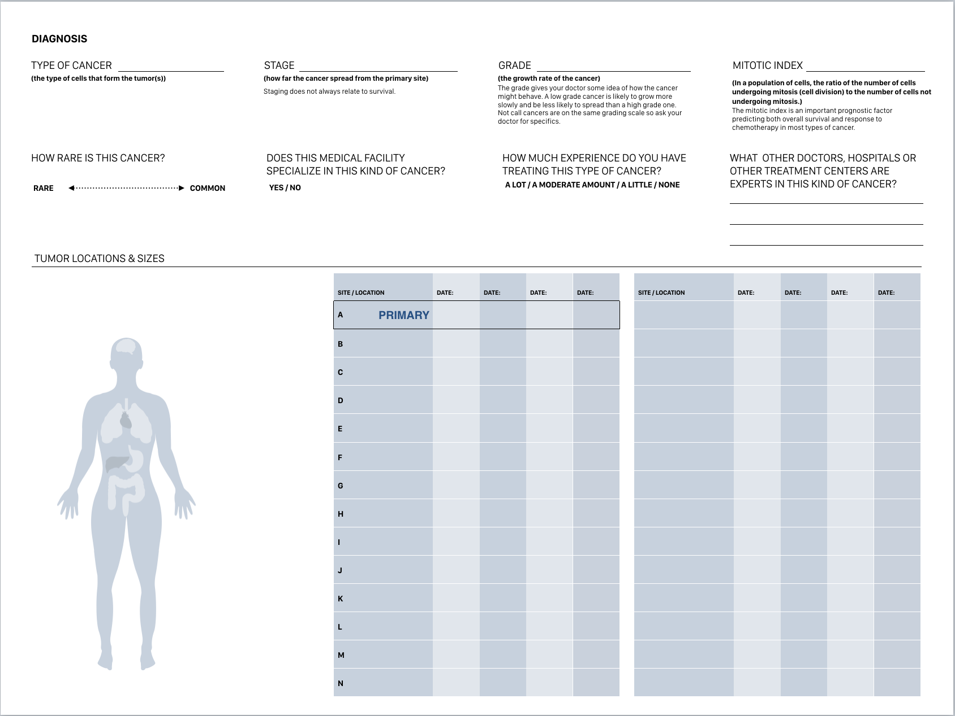
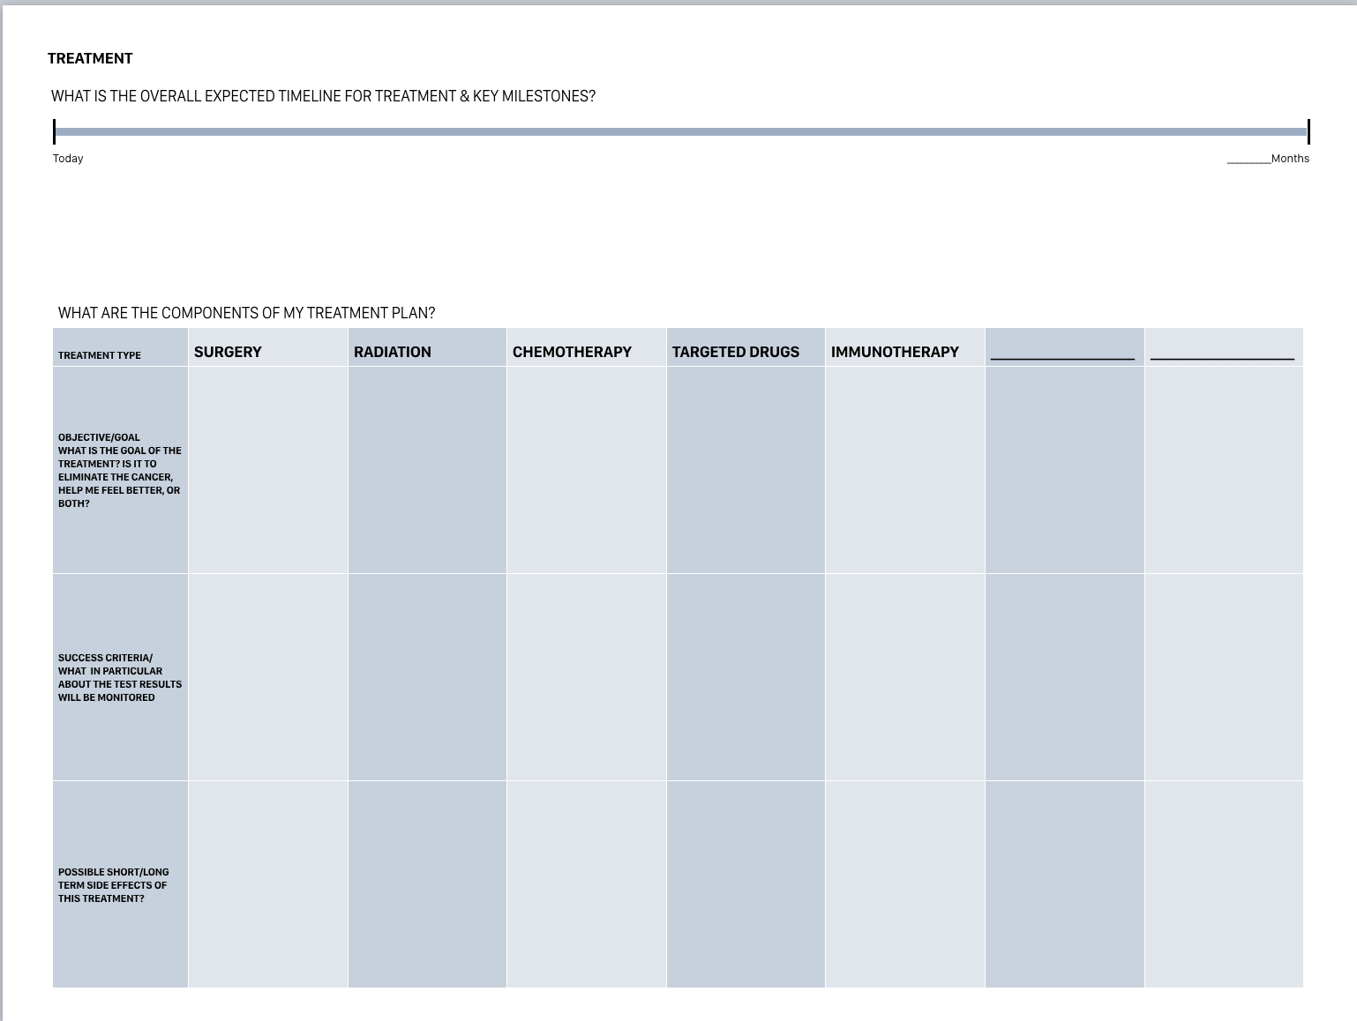
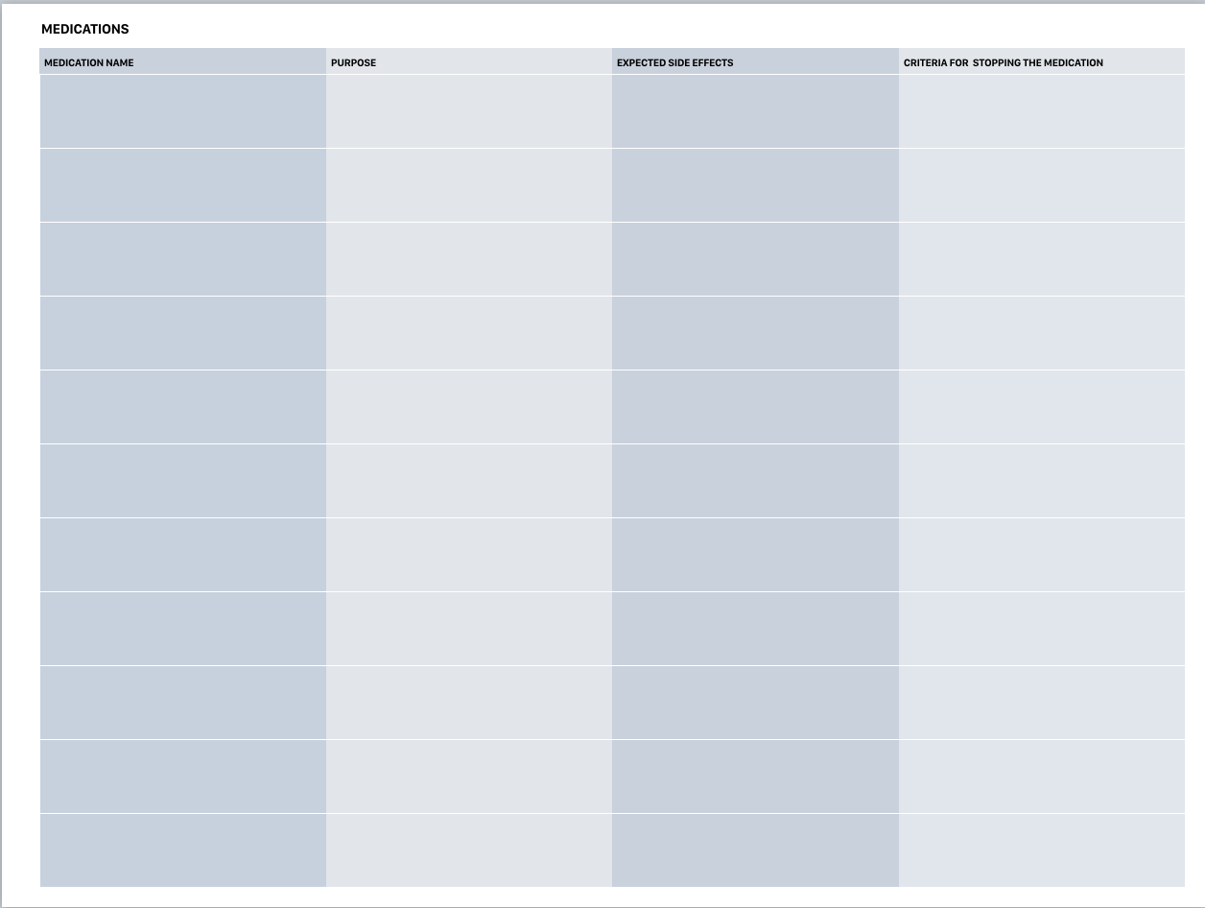
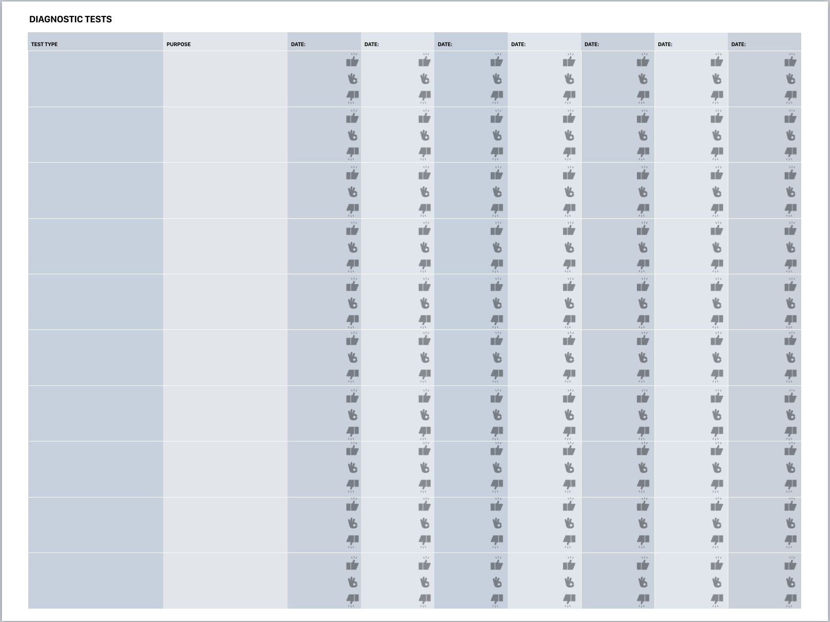
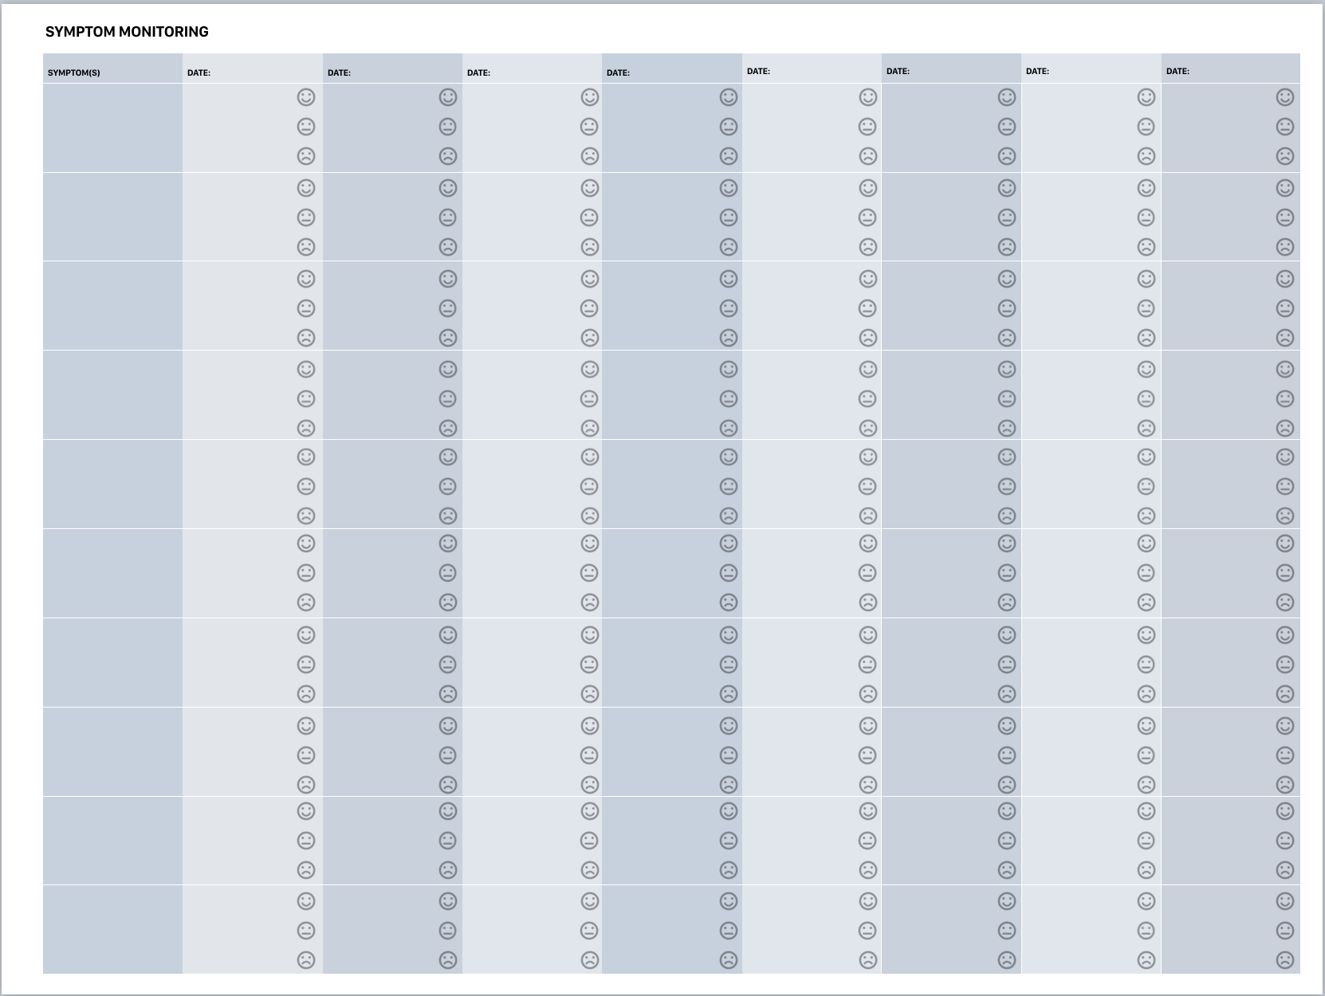
HOW TO USE THESE WORKSHEETS
These worksheets are most useful when you sit shoulder to shoulder with your doctor and fill them out together. Some doctors are reluctant to share bad news with patients or caregivers, however these worksheets can function as a “neutral third party” to help navigate difficult discussions. If your doctor is unwilling, try the nurses (they are usually more empathic and helpful). If you are getting resistance to answers to any of your questions, get a second opinion and/or switch doctors. Without clear, straightforward information neither you or your caregivers can make informed decisions.
Remember:
A cancer diagnosis is NOT a death sentence
Your healthcare providers should be working for YOU and if you feel that they are not, you have every right to move along. The fact is, some doctors don’t care about you as a person and just see you as a set of test results. If that’s the case, find someone else A.S.A.P.
As much as you’d like to not know the scary details, you are better off knowing them. If you are too ill to manage this process, find a friend or family member who can help you.
There are a number of cancer-specific support groups on Facebook and other places online and people are always willing to help you through this process.
There are also remote second opinions that you can get from various cancer-specific hospitals if you are too ill to travel to other hospitals
DIAGNOSIS
TREATMENT
MEDICATIONS
DIAGNOSTIC TESTS
SYMPTOM MONITORING
You can always print out multiple sheets if you need extra room!

Slide 2
DIAGNOSIS
TYPE OF CANCER
STAGE
GRADE
MITOTIC INDEX
(the type of cells that form the tumor(s))
(how far the cancer spread from the primary site)
(the growth rate of the cancer)
(In a population of cells, the ratio of the number of cells undergoing mitosis (cell division) to the number of cells not undergoing mitosis.)
Staging does not always relate to survival.
The grade gives your doctor some idea of how the cancer might behave. A low grade cancer is likely to grow more slowly and be less likely to spread than a high grade one. Not call cancers are on the same grading scale so ask your doctor for specifics.
The mitotic index is an important prognostic factor predicting both overall survival and response to chemotherapy in most types of cancer.
HOW RARE IS THIS CANCER?
DOES THIS MEDICAL FACILITY SPECIALIZE IN THIS KIND OF CANCER?
How much experience do you have treating this type of cancer?
WHAT OTHER DOCTORS, HOSPITALS OR OTHER TREATMENT CENTERS ARE EXPERTS IN THIS KIND OF CANCER?
YES / NO
A LOT / A MODERATE AMOUNT / A LITTLE / NONE
RARE COMMON
TUMOR LOCATIONS & SIZES
SITE / LOCATION |  | DATE: | DATE: | DATE: | DATE:
A | PRIMARY
B
C
D
E
F
G
H
I
J
K
L
M
N
SITE / LOCATION |  | DATE: | DATE: | DATE: | DATE:

Slide 3
TREATMENT
WHAT IS THE OVERALL EXPECTED TIMELINE FOR TREATMENT & KEY MILESTONES?
Today
_________Months
WHAT ARE THE COMPONENTS OF MY TREATMENT PLAN?
TREATMENT TYPE | SURGERY | RADIATION | CHEMOTHERAPY | TARGETED DRUGS | IMMUNOTHERAPY | __________________________ | __________________________
OBJECTIVE/GOAL What is the goal of the treatment? Is it to eliminate the cancer, help me feel better, or both?
SUCCESS CRITERIA/ What in particular about the test results will be monitored
POSSIBLE SHORT/LONG TERM SIDE EFFECTS OF THIS TREATMENT?

Slide 4
DIAGNOSTIC TESTS
TEST TYPE | PURPOSE | DATE: | DATE: | DATE: | DATE: | DATE: | DATE: | DATE:

Slide 5
MEDICATIONS
MEDICATION NAME | PURPOSE | EXPECTED SIDE EFFECTS | CRITERIA FOR STOPPING THE MEDICATION

Slide 6
SYMPTOM MONITORING
SYMPTOM(S) | DATE: | DATE: | DATE: | DATE: | DATE: | DATE: | DATE: | DATE:

